Slide 1
Mozart: a music game
胡圣然 曹畅 艾君达
李文博 周文迪
Oct. 10 2019

Slide 2
Part 1: motivation
Given by 胡圣然

Slide 3
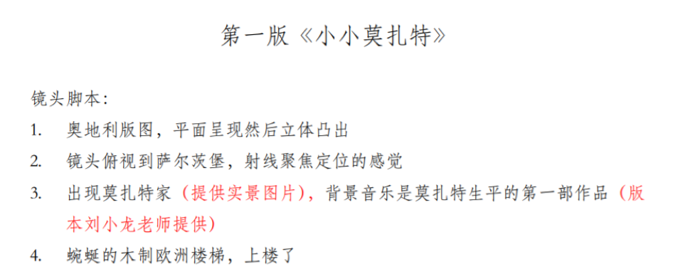
Why we decide to make a music game
The idea of classic music education
A game with fun and knowledge

Slide 4
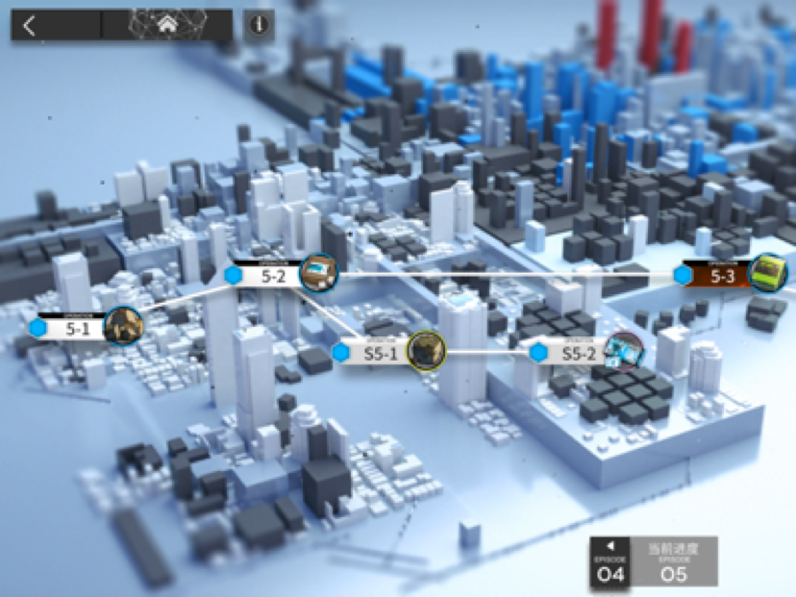
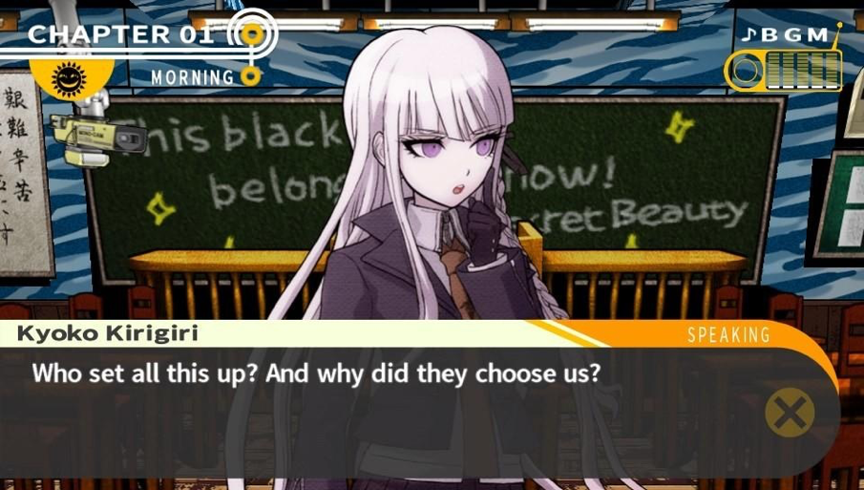
What game is it
A level based game, with Mozart’s life story

Slide 5
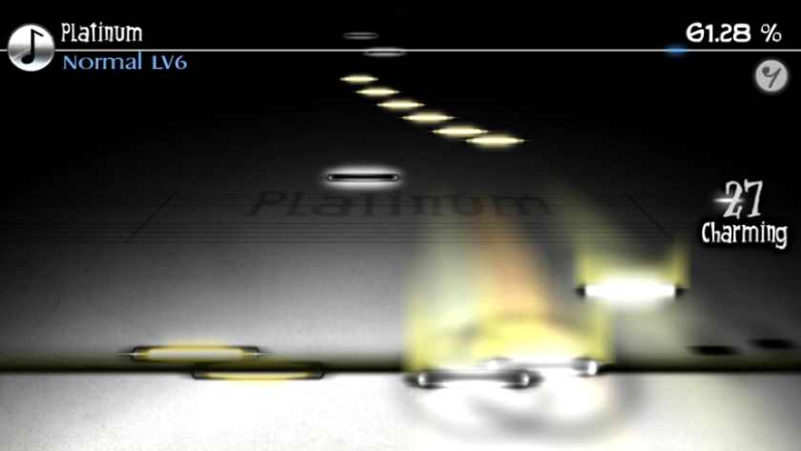
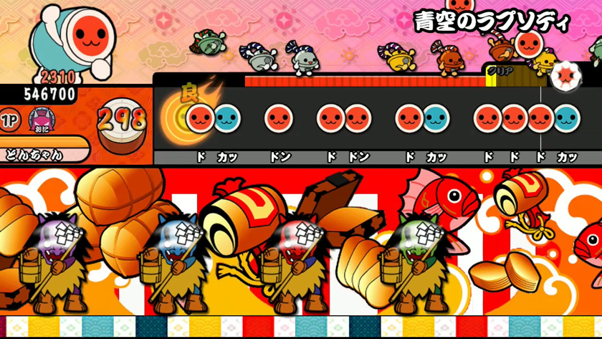
What game is it
Exciting level. Enjoy the fun of music game and classic music

Slide 6
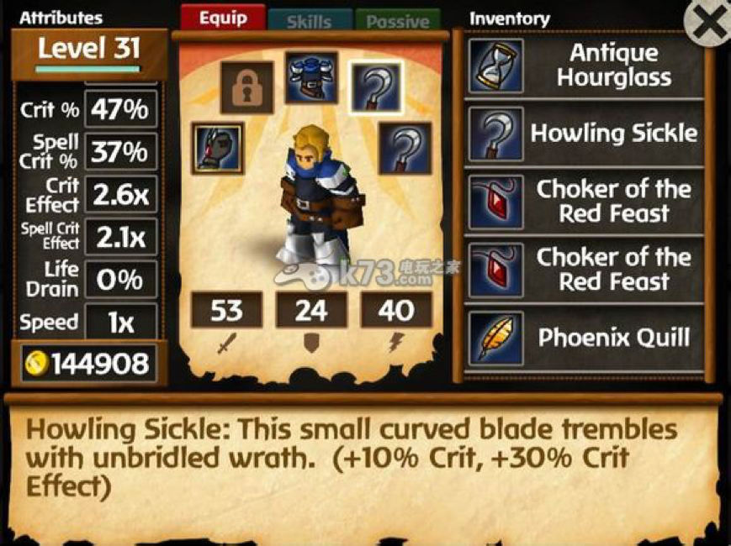
What game is it
RPG

Slide 7
Part 2: Feature description
Given by 曹畅

Slide 8
People of different ages have different cognitions and different demands.
Provide features that meet with variable demands.
All age groups!
4 user stories

Slide 9
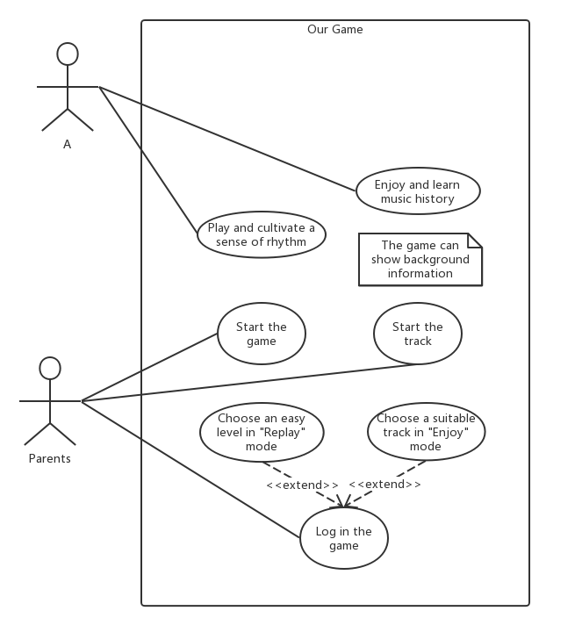
Use case 1
Name: A
Gender: girl
Age: 6
Situation: kindergarten, learn the world
Gain: sense of rhythm, knowledge of classical music

Slide 10
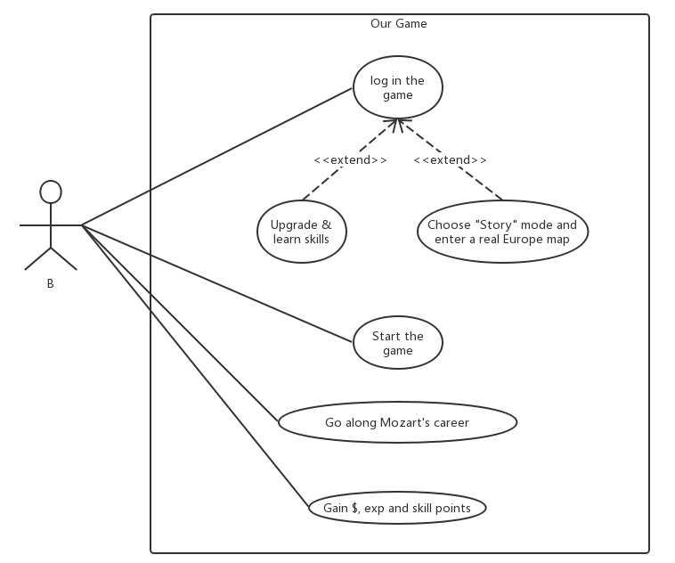
Use case 2
Name: B
Gender: boy
Age: 16
Situation: grade 10 middle school, want to play games in spare time
Gain: interest of classical music, deeper knowledge of Mozart, fun of RPG and development game (养成游戏)

Slide 11
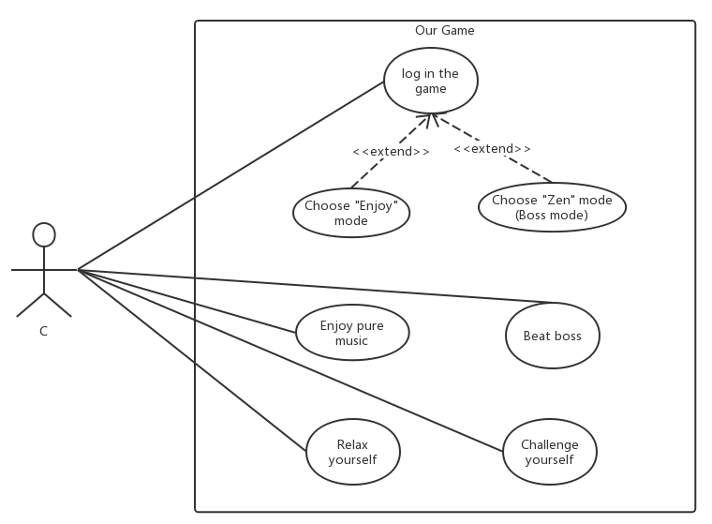
Use case 3
Name: C
Gender: male
Age: 30
Situation: office clerk, heavy workload
Gain: relax, delight of challenge

Slide 12
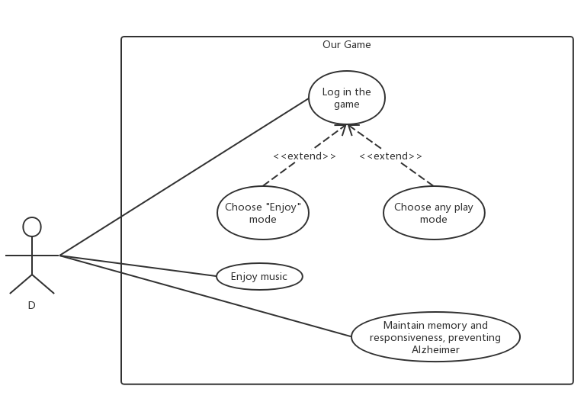
Use case 4
Name: D
Gender: female
Age: 65
Situation: retired, boring, decreased memory and responsiveness
Gain: enjoy music as the elders always do, prevent Alzheimer

Slide 13
Part 3: requirements
Given by 艾君达

Slide 14
Functional Requirements
General Goal: A stand-alone musical game that runs on Windows desktop.
Restraints:
Memory cost
CPU cost
Financial cost
Duration requirement

Slide 15
Functional Requirements
General Goal: A stand-alone musical game that runs on Windows desktop.
Game Modes:
Story mode
Zen mode
Simulation mode

Slide 16
Non-functional Requirements
General Goal: Easy to get on and appeal to people cross age, culture and gender.
Great music collection:
Respecting the historical facts
Highly distinguishable, iconic composes

Slide 17
Non-functional Requirements
General Goal: Easy to get on and appeal to people cross age, culture and gender.
Intuitive, beautiful, smooth UI and UX:
Beautiflul patterns, layout, and font
Instant feedback
Smooth but not too distracting transition animation

Slide 18
Part 4: design document
Given by 李文博

Slide 19
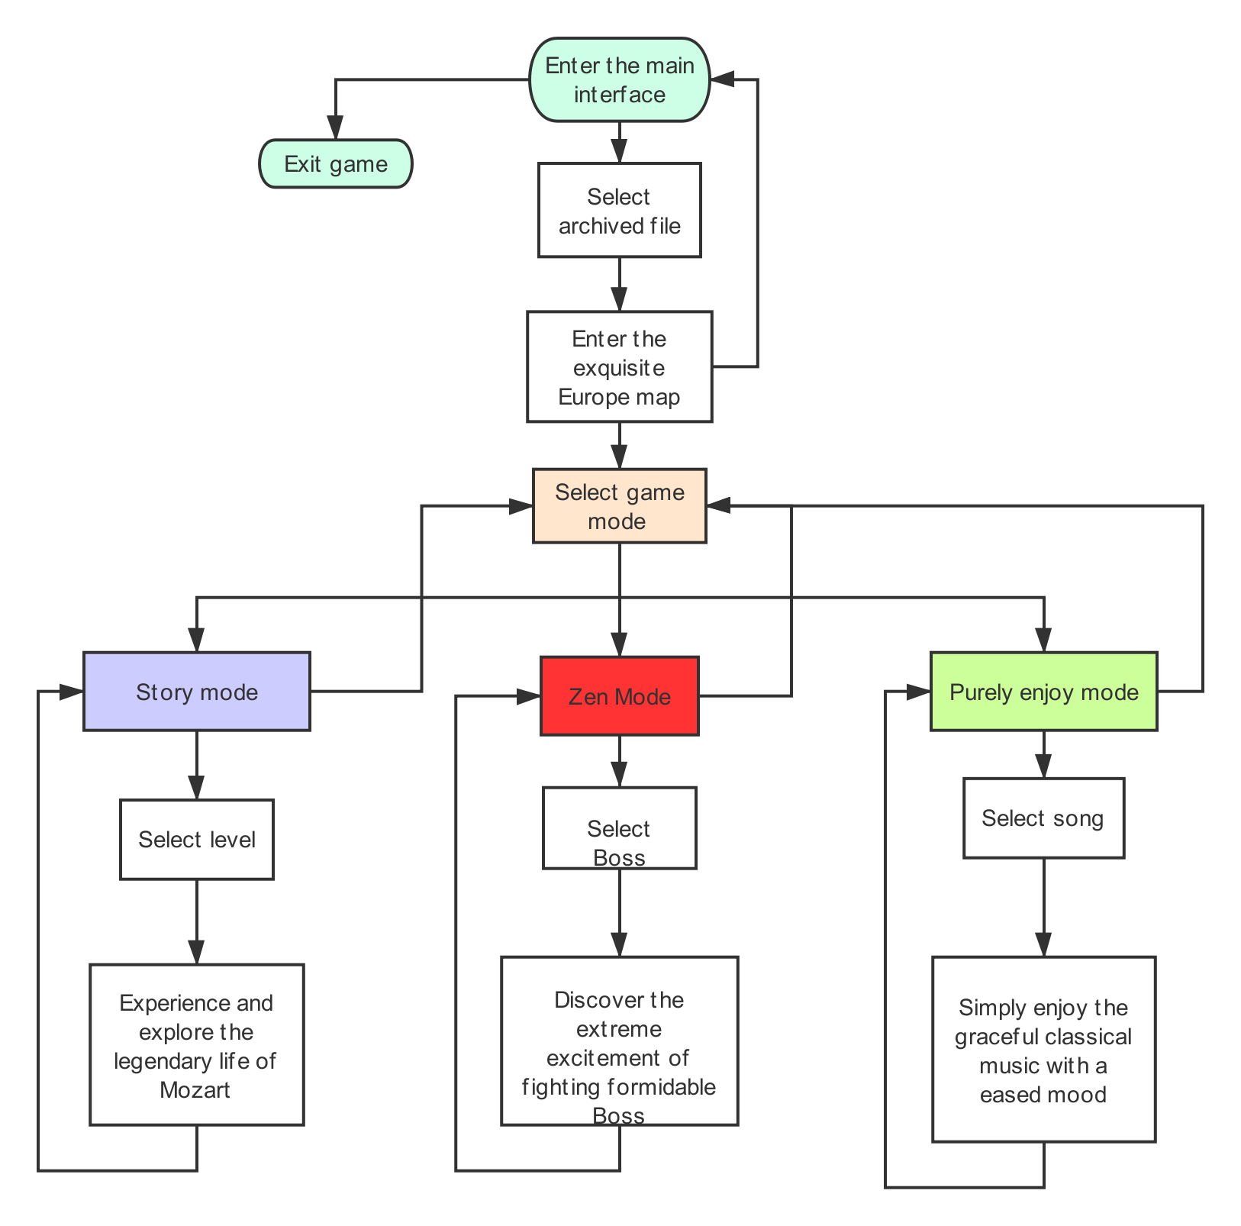
Flow chart

Slide 20
API and Techniques
Game engine: Unity
Map-making, 3-D modeling: MagicaVoxel
UI,Art design: Photoshop, Procreate, Omnigraffle etc.
Database: mySQL
Logic design, Programming: Visual Studio etc.
Music Score design: FL Studio

Slide 21
Part 5: timeline & feasibility
Given by 周文迪

Slide 22
10.7 Determine the overall schema of the game.
10.13-10.21 Implement the basic functions for a music game.
10.24- 11.8 Rest for about 2 weeks, prepare for mid-term exams.
11.9-11.15 Implement the basic UI-design, implement the function of displaying game story and plot, have a new discussion about the game balance and design.
11.16-11.22 Finish all the basic functions of the game, launch our first runnable demo.

Slide 23
11.23-11.29 Append new game instances, melody, CG, stories and maps.
11.30-12.6 Polish new game instances, melody, CG, stories and maps.
12.6-12.13 Testing, debug, improve user experience etc.
12.13-12.22 Finish off, prepare for our presentation.

Slide 24
Implement a game need high quality art. We can make the art ourselves but it may also be extremely time consuming.
Most of our group member don’t know Mozart very well.
We don’t know much about music, our game may not be a very outstanding music game
We are not very familiar with Unity, 3D modeling, music composition
We have designed many features, and we are not very sure about the workload since we don’t have experience before.

Slide 25
Thank You
Coming Soon

